Slide 1

A Physics-Informed Vector Quantized Autoencoder for Data Compression of Turbulent Flow
Mohammadreza Momenifar
Enmao Diao
Vahid Tarokh
Andrew Bragg
Pratt School of Engineering
Duke University
1
Notes:
Hello everyone, My name is Enmao Diao. I will talk about our work A Physics-Informed Vector Quantized Autoencoder for Data Compression of Turbulent Flow.

Slide 2
Motivation
Large-scale data from three-dimensional (3D) high-fidelity simulations of turbulent flows is memory intensive, requiring significant resources to store, transfer and process the data
This major challenge highlights the need for data compression techniques. This motivated us to propose an attractive solution for situations where fast, high quality and low-overhead encoding and decoding of large data are required
2
Notes:
The motivation of our work is to compress large scale data from three-dimensional (3D) high-fidelity simulations of turbulent flows. The high-fidelity simulation data of three-dimensional turbulent flows are typically memory intensive and requiring significant computation resources to store, transfer and process. This major challenge highlights the need for data compression techniques. This motivated us to propose an attractive solution for situations where fast, high quality and low-overhead encoding and decoding of large data are required such as pumps, heat exchanges, and atmospheric pollution transport. The main goal of such compression processes is to truncate the size of the data files while also ensuring that first simulation restarts using the compressed data would not significantly impact the long-term behavior of the simulated flow and second the compressed data still preserves the essential statistical properties of the turbulent flow with reasonable accuracy.

Slide 3
Proposed Framework
We propose a physics-informed Deep Learning framework to generate a discrete low-dimensional representation of velocity field data of three-dimensional turbulent flow simulations
Our method can offer at least compression ratio (CR) = 85 and predictions that faithfully reproduce the statistics of the flow, except at the very smallest scales
3
Notes:
Machine learning techniques are bringing fresh perspectives in many areas. Among machine learning techniques, deep learning models have received significant attention due to their ability to capture complex interactions and achieve outstanding performance across a wide range of applications in information technology, healthcare and engineering. In the context of data compression, common deep neural networks are based on an autoencoder architecture, which has also gained interest in the Computational Fluid Dynamics (CFD) community for the purpose of data compression of three-dimensional turbulent flows. We propose a physics-informed Deep Learning framework to generate a discrete low-dimensional representation of velocity field data of three-dimensional turbulent flow simulations. This approach involves a calibration process that enables infusing prior physics-informed knowledge of the data to boost the performance of model. Our method can offer at least compression ratio (CR) = 85 and predictions that faithfully reproduce the statistics of the flow, except at the very smallest scales Compared to the recent autoencoder network, training our framework is computationally much cheaper and the trained model significantly improves not only the compression ratio but also the accuracy of the reconstructed data.

Slide 4
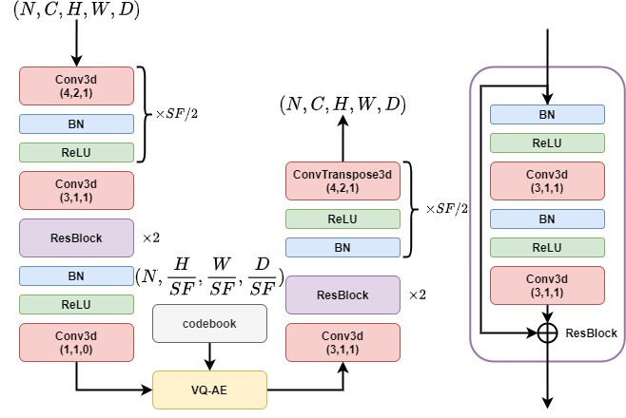
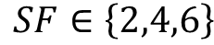
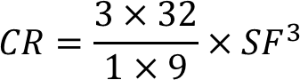
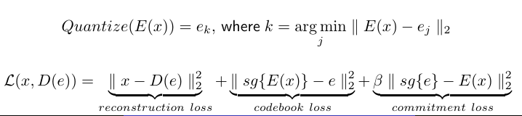
Model Architecture
Vector Quantized Autoencoder (VQ-AE) [1] learns a discrete (rather than continuous), low-dimensional representation of data
Scaling Factor (SF) and Compression Ratio (CR)
4
[1] Van Den Oord, Aaron, and Oriol Vinyals. "Neural discrete representation learning." Advances in neural information processing systems 30 (2017).
Notes:
The main difference between our framework and previous studies is that we incorporate the concept of vector quantization and generate a bottleneck representation in a discrete space. Furthermore, we infuse prior physics-informed knowledge of the data into the model to enhance the ability of model in respecting the small-scale characteristics of the turbulence which were not well-captured in previous works. A Vector-Quantized autoencoder encodes the input data in a discrete latent space and can effectively use the capacity of latent space by conserving important features of data that usually span many dimensions in data space (such as objects in images) and reducing entropy (putting less focus on noise). Compared to a conventional autoencoder, a Vector-Quantized Autoencoder has an additional Vector-Quantizer module. The encoder (E) serves as a non-linear function that maps input data (x) to a vector E(x). The quantizer module takes this vector and outputs an index (k) corresponding to the closest codeword in the codebook to this vector (e_k). the reconstruction loss trains both encoder and decoder parameters where the gradient of reconstruction error is back-propagated to the decoder first, and then directly passed to the output of the encoder using the straight-through gradient estimator.

Slide 5
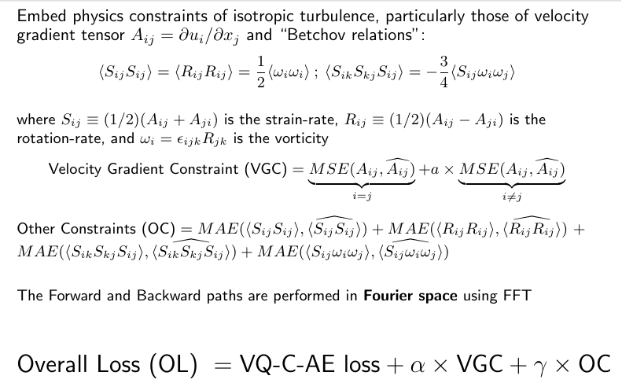
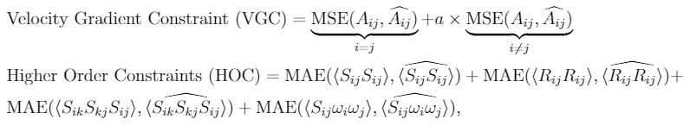

Prior Physics-Informed Knowledge
Incorporating prior physics-informed knowledge into framework
5
Notes:
As noted earlier, preserving small-scale properties of the turbulent flow was a challenge for prior compression models. It may be of interest to add appropriate constraints in order to capture these more faithfully. Given that our model will be trained on isotropic turbulence, the appropriate constraints for this kind of flow will be our main focus here. Let us consider the Cartesian components of the velocity gradient tensor, Aij = ∂ui/∂xj . The incompressibility of the flow implies that Aii = 0. Furthermore, “Betchov relations” [15] for an incompressible, statistically homogeneous turbulent flow are given here. where Sij is the strain-rate, Rij is the rotationrate, and ωi is the vorticity. The coefficient a is introduced in equation 6 to account for the differences in the statistics of the longitudinal and transverse components. For example, at the small-scales of isotropic turbulence, the variance of the transverse velocity gradients are twice the size of the longitudinal ones. We penalize the deviations in the Higher order constraints with mean absolute error (MAE), which is less sever than the MSE in the velocity gradient constraint, in order to put less focus on this term as it is a secondary objective. Finally adding these constraints as regularization terms to VQ-AE loss function gives the overall loss function.

Slide 6
Experimental Setup
We train our model via only 40 realizations from Direct Numerical Simulation (DNS) data of a three-dimensional, statistically stationary, isotropic turbulent flow simulated on a cubic domain with 128 grid point in each direction
We implemented this framework with PyTorch. The training (one NVIDIA Pascal P100 GPU) was completed within approximately 8 hours, and the maximum GPU memory consumed was around 5 GB
6
Notes:
We train our model using high-fidelity DNS data of a three-dimensional, statistically stationary, isotropic turbulent flow with Taylor-Reynolds number 90, solved on a cubic domain with 128 grid points in each direction. In our training data set we have 40 snapshots (as opposed to 3000 in the recent study of [8]) equally spaced in time. We implemented this framework with PyTorch. The training with one GPU was completed within approximately 8 hours, and the maximum GPU memory consumed was around 5 GB.

Slide 7
Evaluation
The model is evaluated using statistical, comparison-based similarity and physics-based metrics (PDFs of velocity gradient tensor and its invariants, Turbulence kinetic energy spectra)
The performance of this lossy data compression scheme is evaluated on a variety of test data on the order of increasing complexity: stationary isotropic turbulence, decaying isotropic turbulence, Taylor-Green vortex flow
7
Notes:
The model is evaluated using statistical, comparison-based similarity and physics-based metrics, for example PDFs of velocity gradient tensor and Turbulence kinetic energy spectra. We test the performance of the trained framework on a variety of flows to determine how well the model can compress flows different from those used in the training. Specifically, we start with statistically stationary isotropic turbulence for training and test other flows such as decaying isotropic turbulence, and a Taylor-Green vortex flow.

Slide 8
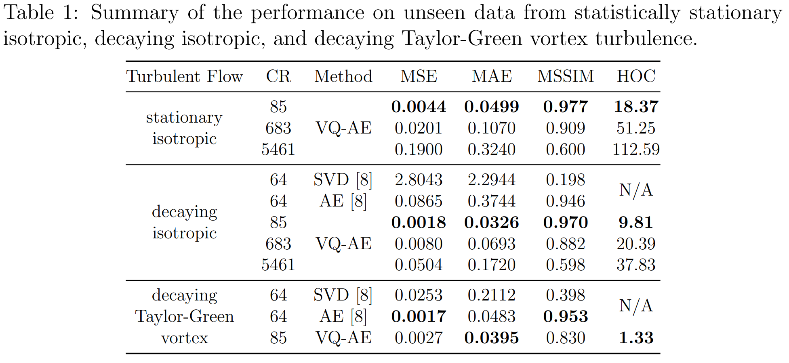
Evaluation
7
Notes:
We demonstrate our quantitative results with respect to the performance of the trained VQ-AE model on an unseen realization from statistically stationary isotropic, decaying isotropic, and Taylor-Green vortex turbulence flow.. The results of SF = 2, CR = 85 indicate t Oour model can capture up to third order statistics of the velocity components with reasonable accuracy while offering 85× compression, meaning an 85× increase in data transfer and 85× decrease in disk usage. Our model with SF = 4, CR = 683 captures most of the information content of the flow and may be employed for the situations where there is less interest in accurate representations of the smallest scales of the flow, i.e. flows with relatively little kinetic energy. Similarly, our model with SF = 8, CR = 5461 may be used when the main interest is in accurately representing the large scales of flow. Compared with the existing workds, our SF = 2 model improves both the MSE and MAE by an order of magnitude, and the MSSIM by 2%, while offering a CR = 85 which corresponds to more than a 30% enhancement in the compressive capabilities. Our results also demonstrate that loss of information occurs at smallest scales of flow, indicated by Higher-Order Constraints (HOC), and is enhanced as we increase CR.

Slide 9
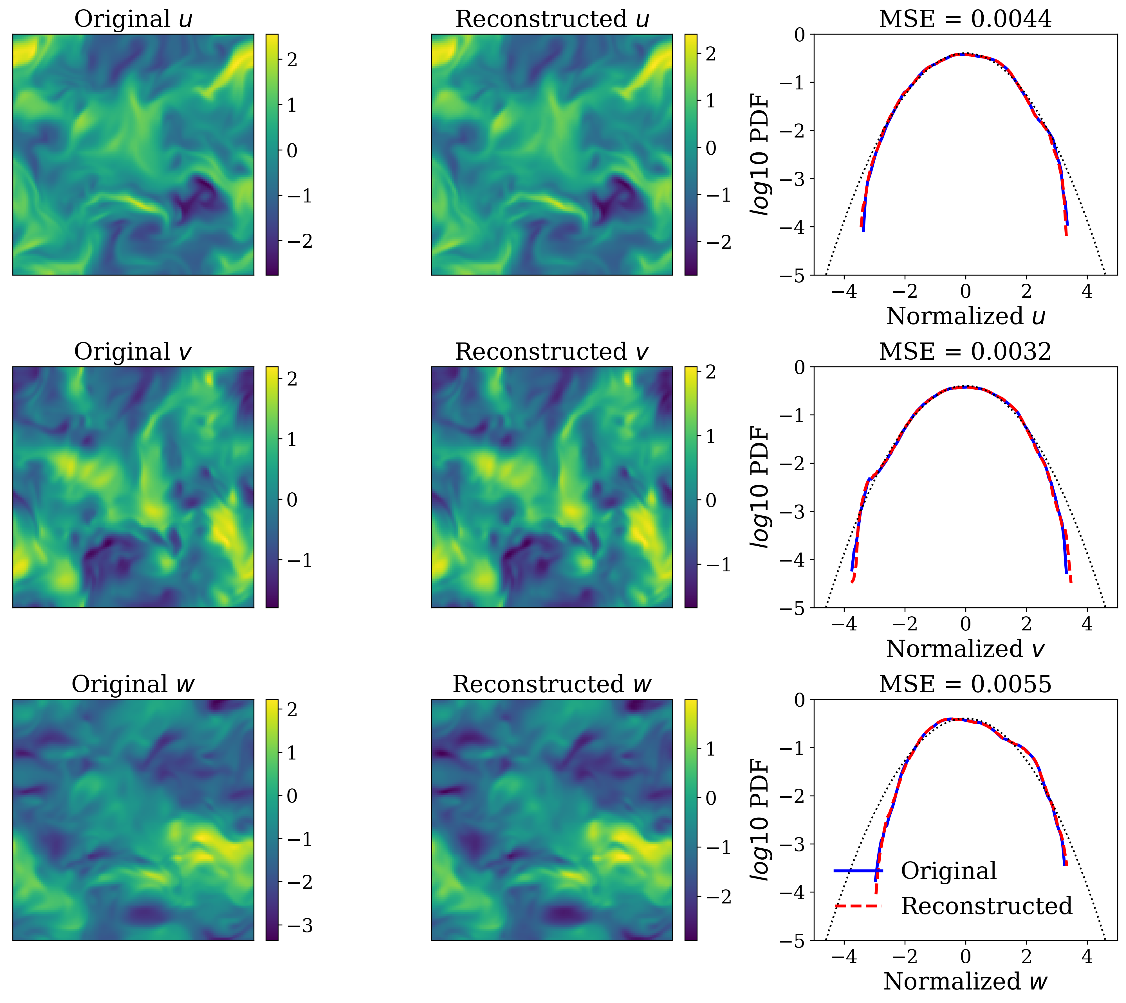
Experimental Results
Figure 1. 2D snapshots and PDFs of velocity components. Comparing original and reconstructed 3D test data from statistically stationary isotropic turbulence compressed via VQ-AE with SF= 2 (CR= 85).
8
Notes:
We illustrate the qualitative results of velocity components and its probability density functions (PDFs) in Figure 2. We show original and reconstructed two dimensional snapshots of three velocity gradient components u, v, w from stationary isotropic, decaying isotropic, and Taylor-Green vortex turbulence flow respectively. The snapshot comparisons show that our model captures very well the instantaneous spatial structure of the flow. The PDF results show that the model accurately captures the statistical properties of the velocity field. Compared to the results of existing works, our model more accurately captures the tails of the PDFs with minor deviations in the far tails.

Slide 10
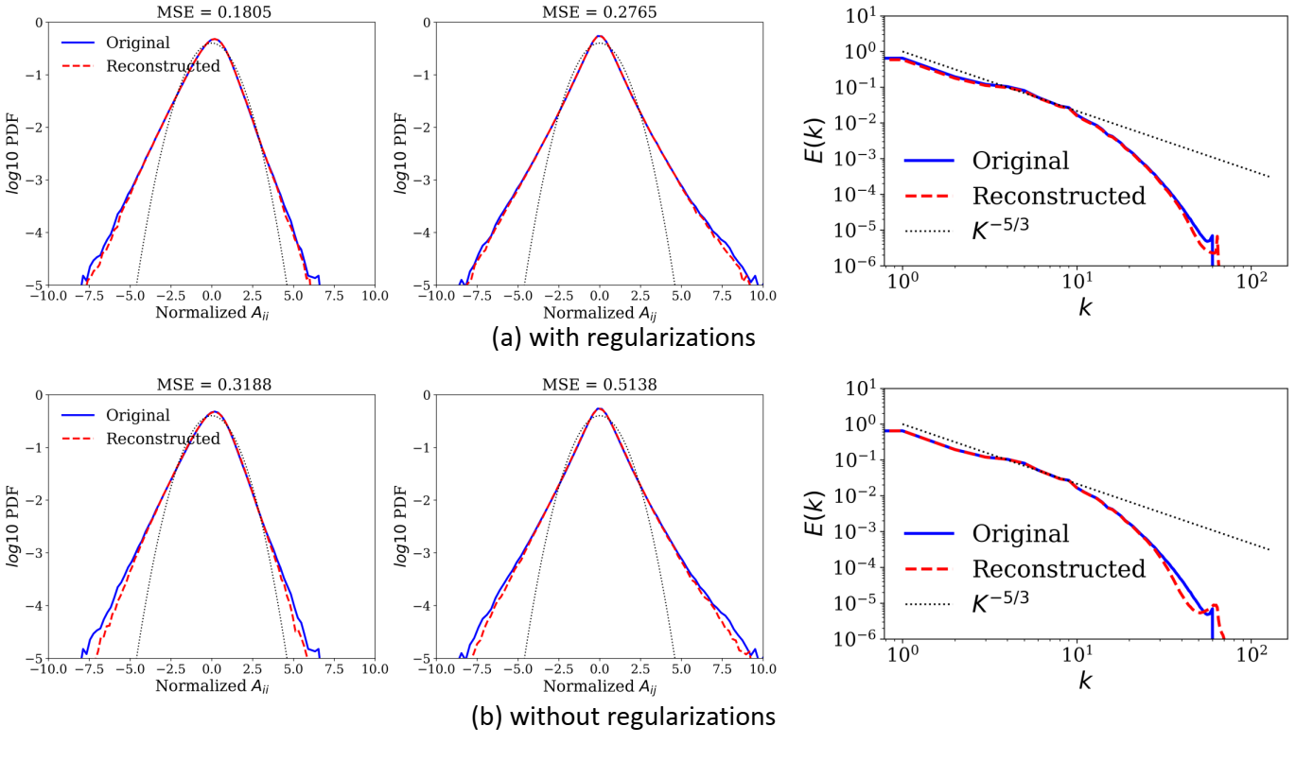
Experimental Results
Figure 2. (a) with and (b) without regularizations for PDFs of normalized longitudinal
(left), transverse (middle) components of velocity gradient tensor A, and Turbulence
Kinetic Energy spectra (right) of stationary isotropic turbulence flow
8
Notes:
To better understand the effect of calibrating the loss function by incorporating physics-informed prior knowledge of the properties of the data, we trained another model without those regularization terms. As shown in Figure 3, including the regularization term enhances the ability of the model to capture the intermittent fluctuations of the velocity gradient characterized by the tails of the PDFs. Furthermore, the results of the Turbulence Kinetic Energy spectra demonstrate that including the regularization term makes some improvement at the smallest scales (highest wavenumbers). The deviation at the smallest wavenumbers (large scales) can be attributed to the fact that in the original data, the energy content at these scales is very small, O(10−32), and so it is hard for the model to retain such precision in the reconstructed data. Nevertheless, the model without regularization already performs well at capturing the properties of the turbulent flow.

Slide 11
Conclusion
We propose a vector quantized deep learning framework, the
so called vector quantized autoencoder or VQ-AE, for the compression of data from turbulent flow simulations
We calibrate the loss function of the model to infuse prior physics-informed knowledge of the flow in the form of constraints in order to boost the model performance
Our data compression framework is not limited to Computational Fluid Dynamics (CFD) simulations but can be easily applied to compress data from other complex physical simulations
16
Notes:
In conclusion ..

